Slide 1

Debugging
The why, where && WTF
behind your error messages…
Hunter T.
Phase 1

Slide 2
Topics Covered
History
Reading Error messages
Different Debugging Strategies
Tools
Cleanup some code (maybe)
Ten most common errors with examples

Slide 3
Why you care
80% of your time as a Dev is spent READING CODE
60% of that time is DEBUGGING
Good Debugging skill is one of the things that will keep you sane in this job…
* All times estimated…. ☺

Slide 4
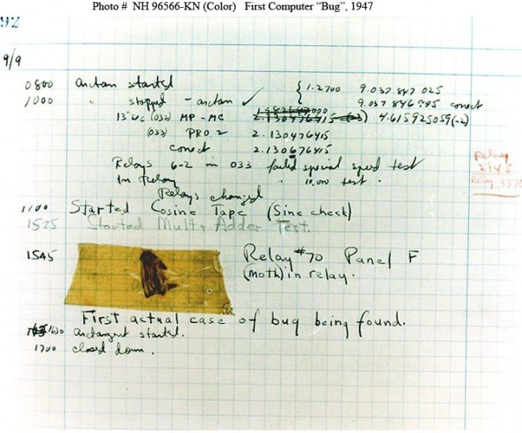
History

Slide 5
Definitions:
DEBUGGING: Any systematic approach undertaken in the understanding and elimination of a BUG.
BUG: Whenever a program/system is not behaving the way we expect.

Slide 6
Gen Knowledge
Debugging is the process of figuring out the source of the error and fixing it.
Think of it as the disconnect between your assumptions and what the code is actually doing.
It's a skill, so you'll need to practice it.
FYI: Helping peers == super great way to improve.

Slide 7
Error Messages

Slide 8
Stack Trace
Stack Trace (aka stack backtrace or stack traceback) is a report of the active stack frames upon error condition during a program’s execution.
We follow this path back to find the offending code segment and correct it.

Slide 9
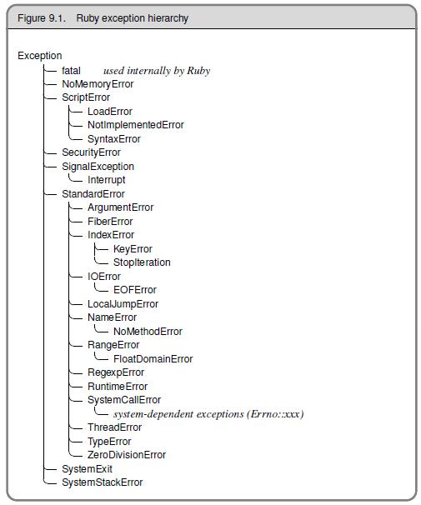
Ruby Exception Classes

Slide 10
Error Messages
The First rule of debugging:

Slide 11
Error Messages
The First rule of debugging:
Read the error message!

Slide 12
Error Messages
The First rule of debugging:
Read the error message!
The Second rule of debugging:

Slide 13
Error Messages
The First rule of debugging:
Read the error message!
The Second rule of debugging:
Read the error message!

Slide 14
Error Messages
The Third rule of debugging:
No matter how fucked you think you are…. Remain CALM!

Slide 15
Errors are your friends!
Don’t freak when you see an error
Analyze the error:
What are the line number(s)?
What type of error is it?
What specific message did you get?

Slide 16
Debugging Workflow
Read your error messages!
SPECIFICS: type, line #, error msg & filename
Know what your expected behavior is.
Shitcan your assumptions.
Verify and understand the input(s).
Verify the program / variable state.
Make small incremental changes.

Slide 17
Strategies
Debug “inline”
Use the REPL (irb || pry)
Guess && Check

Slide 18
Debugging “inline”
Use p statements to quickly show variable’s value p “some_variable: #{@some_variable}”
Quickly determine if you are reaching a method
def some_method p “HIT: some_method” end

Slide 19
Debugging “inline”
Terrific way to determine flow control around conditional statements if num = 1 p “inside if” else p “inside else” end

Slide 20
Debugging “inline”
Use “signaling code” to easily flag your spot in conjunction with a variable check p “~” * 80
p “var: #{var}”
p “~” * 80
This is very useful in larger applications or when p-ing to a busy server console.
Tip: Use different signal characters when looking at multiple points in your code.

Slide 21

Tools

Slide 22
awesome_print
gem install awesome_print
require ‘awesome_print’
ap some_array
ap some_hash

Slide 23
PRY – The IRB Alternative
Pry is a REPL (Read-Eval-Print-Loop) much like IRB but with 3 additional key features:
Syntax Highlighting
Built in methods
A Debugger
Tabbed completion

Slide 24
PRY – Install
gem install pry
gem install pry-doc
gem install pry-byebug
rbenv rehash

Slide 25
PRY – terminal commands
ls (list methods)
_ (the last output)
? (show-doc)
. (send command to bash)
cat filename (displays the given file)
wtf? (wtf………)

Slide 26
pry-byebug
gem install pry-byebug
require "pry-byebug”
To stop execution and enter the REPL insert
binding.pry
as a breakpoint at the spot you wish to examine.

Slide 27
pry-byebug commands
!!!: Quit byebug session and resume
step: Step execution into the next line or method. Takes an optional numeric argument to step multiple times.
next: Step over to the next line within the same frame. Also takes an optional numeric argument to step multiple lines.
finish: Execute until current stack frame returns.
continue: Continue program execution and end the Pry session.
up: Moves the stack frame up. Takes an optional numeric argument to move multiple frames.
down: Moves the stack frame down. Takes an optional numeric argument to move multiple frames.

Slide 28
PRY#show-doc

Slide 29
Exceptions
An instance of the Exception class
A raised exception will propagate through each method in the call stack until it is stopped or reaches the point where the program started
Exceptions can be Raised && Rescued

Slide 30
Debugging Wrapup
Questions?

Slide 31
Sweet Links
Pry Usage (youtube)
Replace IRB with PRY

Slide 32
Final Thought
Don’t like debugging…
A Strong test suite
will greatly reduce the
amount of debugging
you do.

Slide 33
What now…

